Slide 1
Breakfastclub
How Personality Traits effect attention and happiness in a simulated classroom
manuel.pasieka@protonmail.ch

Slide 2
How different personalities effect classroom attention and happiness?

Slide 3
Content
Agent based model
Big Five Personality Traits
Breakfastclub
Results

Slide 4
Agent based models
An agent-based model (ABM) is a class of computational models for
simulating the actions and interactions of autonomous agents (both
individual or collective entities such as organizations or groups) with
a view to assessing their effects on the system as a whole.
- Wikipedia
Applied in various fields
Biology (e.g. epidemics)
Economics (e.g. Stock Trade)
Social Studies (e.g. Social Networks)

Slide 5
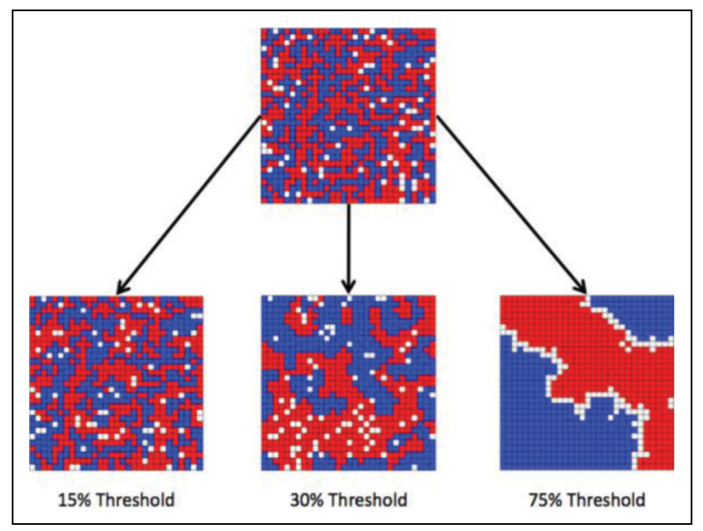
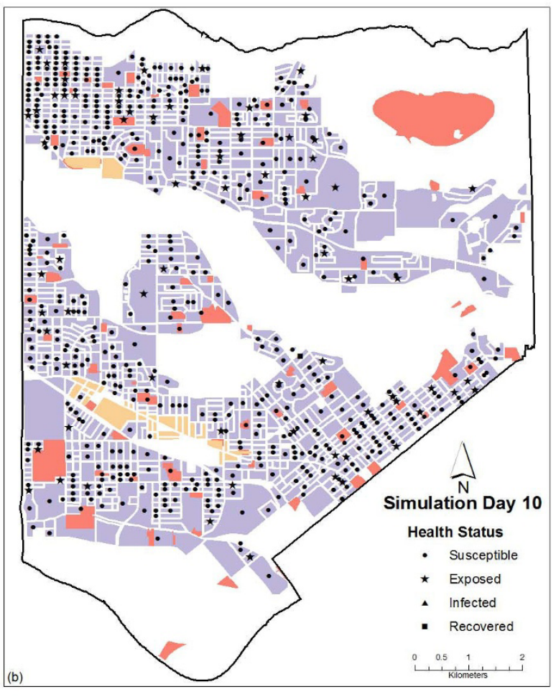
Agent based models - Examples
﻿Thomas Schelling’s (1971) – Social Segregation [1]
Perez (2009) – Contagious disease spread [2]
[1] Schelling, T. C. (1971). Dynamics Model of Segregation. Journal of Mathematical Sociology, 1(May 1969), 143–186.
[2] Perez, L., & Dragicevic, S. (2009). An agent-based approach for modeling dynamics of contagious disease spread.
International Journal of Health Geographics, 8(1), 1–17. https://doi.org/10.1186/1476-072X-8-50

Slide 6
How to measure and study personality?

Slide 7
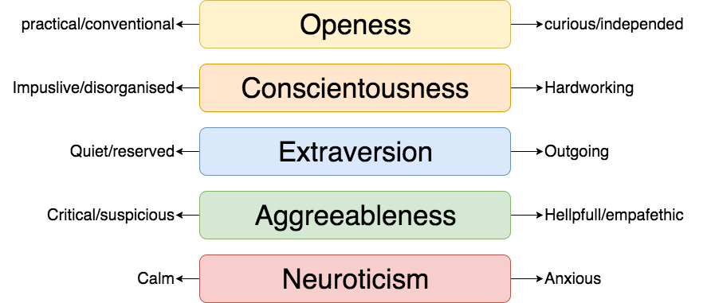
Big Five – Personality Trait Model
Controversial but widely applied in theoretical and practical settings is the empirical OCEAN or Big Five Personality Trait model[1].
[1] Norman, W. T. (1963). Toward an adequate taxonomy of personality attributes. Journal of Abnormal and Social Psychology, 66(6), 574–583. https://doi.org/10.1037/h0040291

Slide 8
Big Five in the classroom
Empirical studies show how the big five effect the behavior or children in the classroom [1]
On school achievements and outcome [2]
Big Five in children with ADHD [3]
[1] Ehrler, D. J., Evans, J. G., & McGhee, R. L. (1999). Extending Big-Five theory into childhood: A preliminary investigation into the relationship between Big-Five personality traits and behavior problems in children. Psychology in the Schools
[2] Asendorpf, J. B., & Van Aken, M. A. G. (2003). Validity of Big Five Personality Judgments in Childhood: A 9 Year Longitudinal Study. European Journal of Personality, 17(1), 1–17. https://doi.org/10.1002/per.460
[3] Nigg, J. T., Blaskey, L. G., Huang-Pollock, C. L., Hinshaw, S. P., John, O. P., Willcutt, E. G., & Pennington, B. (2002). Big five dimensions and ADHD symptoms: Links between personality traits and clinical symptoms. Journal of Personality and Social Psychology, 83(2), 451–469. https://doi.org/10.1037/0022-3514.83.2.451

Slide 9
Can we build a agent based model based on the Big Five, simulating a classroom?

Slide 10
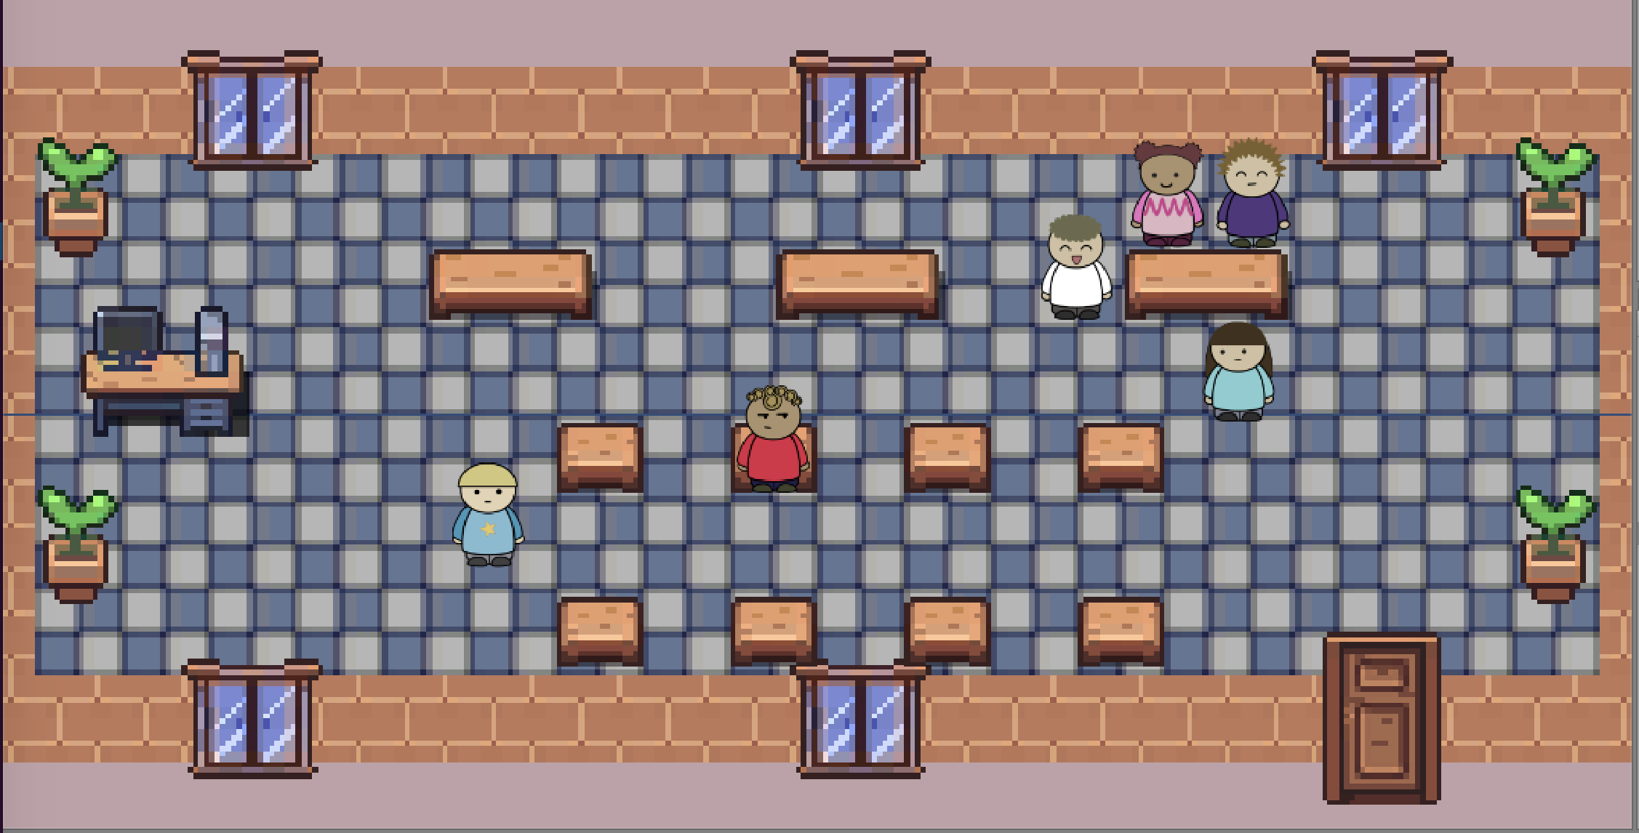
Breakfastclub
Agent based model implemented in Unity3D
Agent behavior is based on OCEAN (Big Five) Personality Trait model
Model attention, happiness and motivation
Different personality profiles are compared to each other
Notes:
selbst lernende gruppe

Slide 11
Agent based models
Main Components
Environment (Defined a limited world)
Agents (Behavior, Characteristics)
Logic (Manage Behavior and Interaction)

Slide 12
Environment
Classroom
Individual tables
Group (4 people) tables
Noise Level

Slide 13
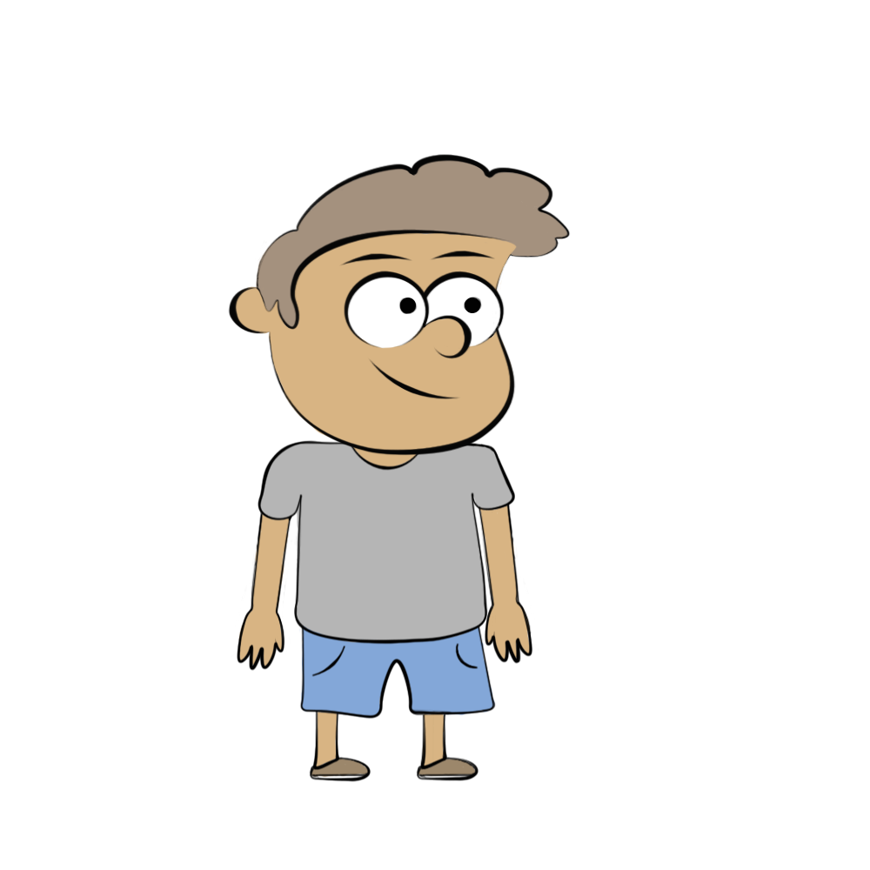
The Agents
Personality
Internal States
Behavior
Openness
Conscientiousness
Extraversion
Agreeableness
Neuroticism
Motivation
Happiness
Attention
Chat
Take a break
Study alone
Study in groups
Quarrel

Slide 14
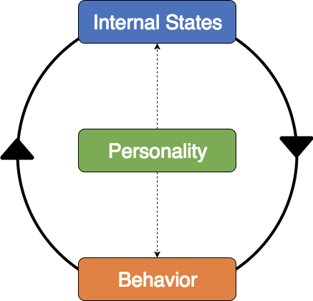
Agent Dynamics
Each Agent is a dynamic system
Parameterized by its Personality Traits
Internal States define and are altered by Agents Behavior
Notes:
Dynamic

Slide 15
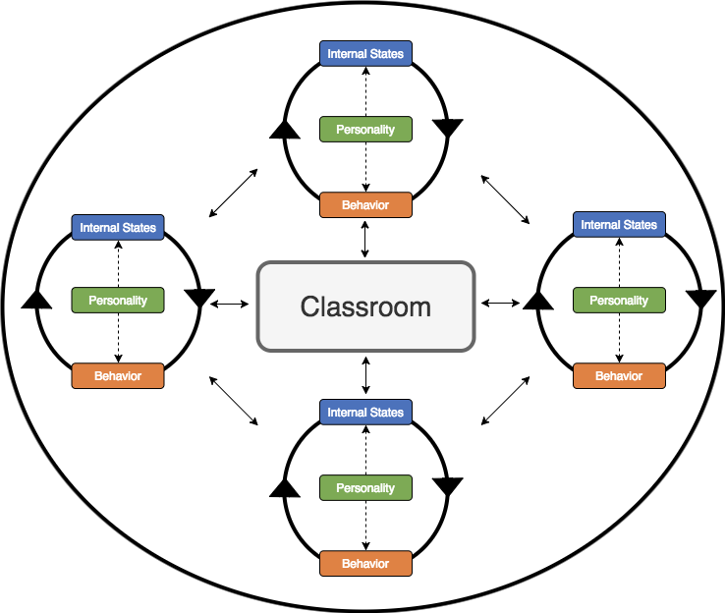
Group Dynamics
Agents interact with each other and the environment
Different Agent Ensembles have different Group dynamics
The system can cause emerging behaviors
Notes:
Dynamic

Slide 16


Logic
Internal States
Behavior
(M)otivation
(H)appiness
M
H
E
Chat
Take a break
Study alone
Study in groups
Quarrel
M
H
E
M
H
E
Ns
iT
Personality
M
H
E
gT
(O)penness
(C)onscientiousness
(E)xtraversion
(A)greeableness
(N)euroticism
M
H
Interaction
Other
C
C
Chat
Quarrel
Action Duration
Attention
A
C
M
Ns

Slide 17
How different personalities effect classroom attention and happiness?

Slide 18
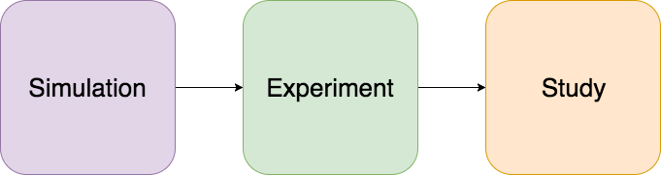
Three phase Analysis
What is the behavior of one set of agents?
What is the average happiness and attention of a combination of personalities?
How do different personality combinations compare to each other?

Slide 19
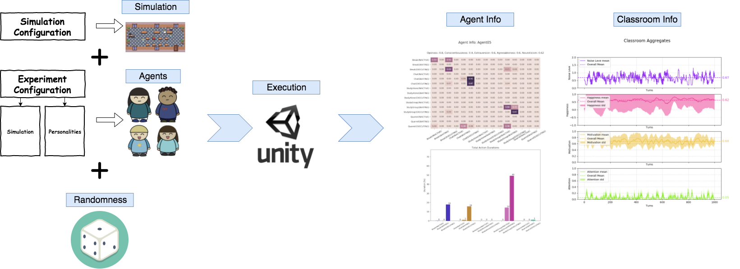
Simulation
What is the behavior of one set of agents?

Slide 20
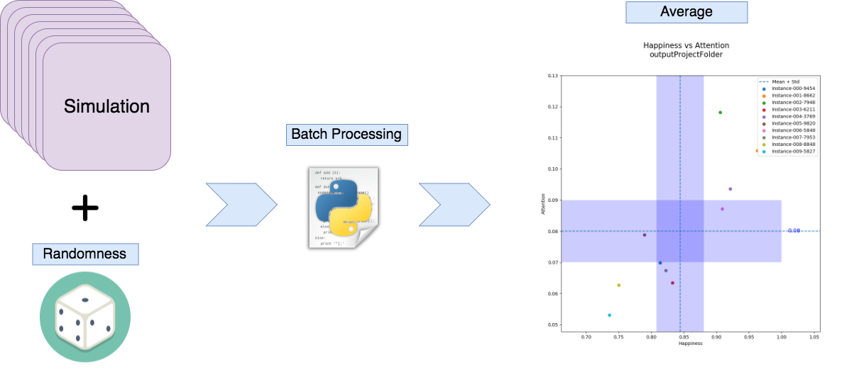
What is the average happiness and attention of a combination of personalities?
Experiment

Slide 21
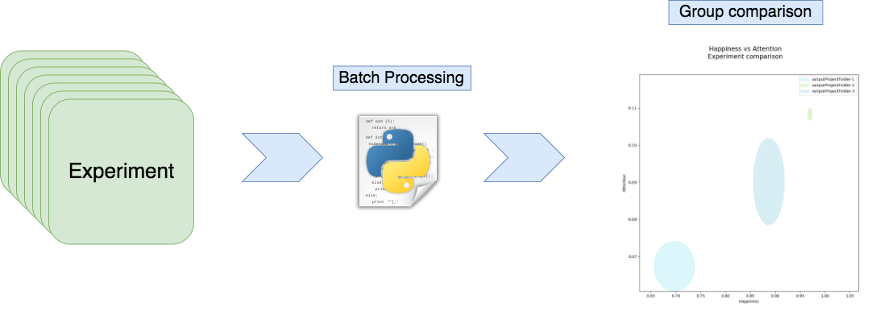
Study
How do different personality combinations compare to each other?

Slide 22
Results

Slide 23
Outlook

Slide 24
Máster Universitario en Inteligencia Artificial
Prof. Dr. Michael Kickmeier-Rust
(Supervisor)
Thank you

